Slide 1
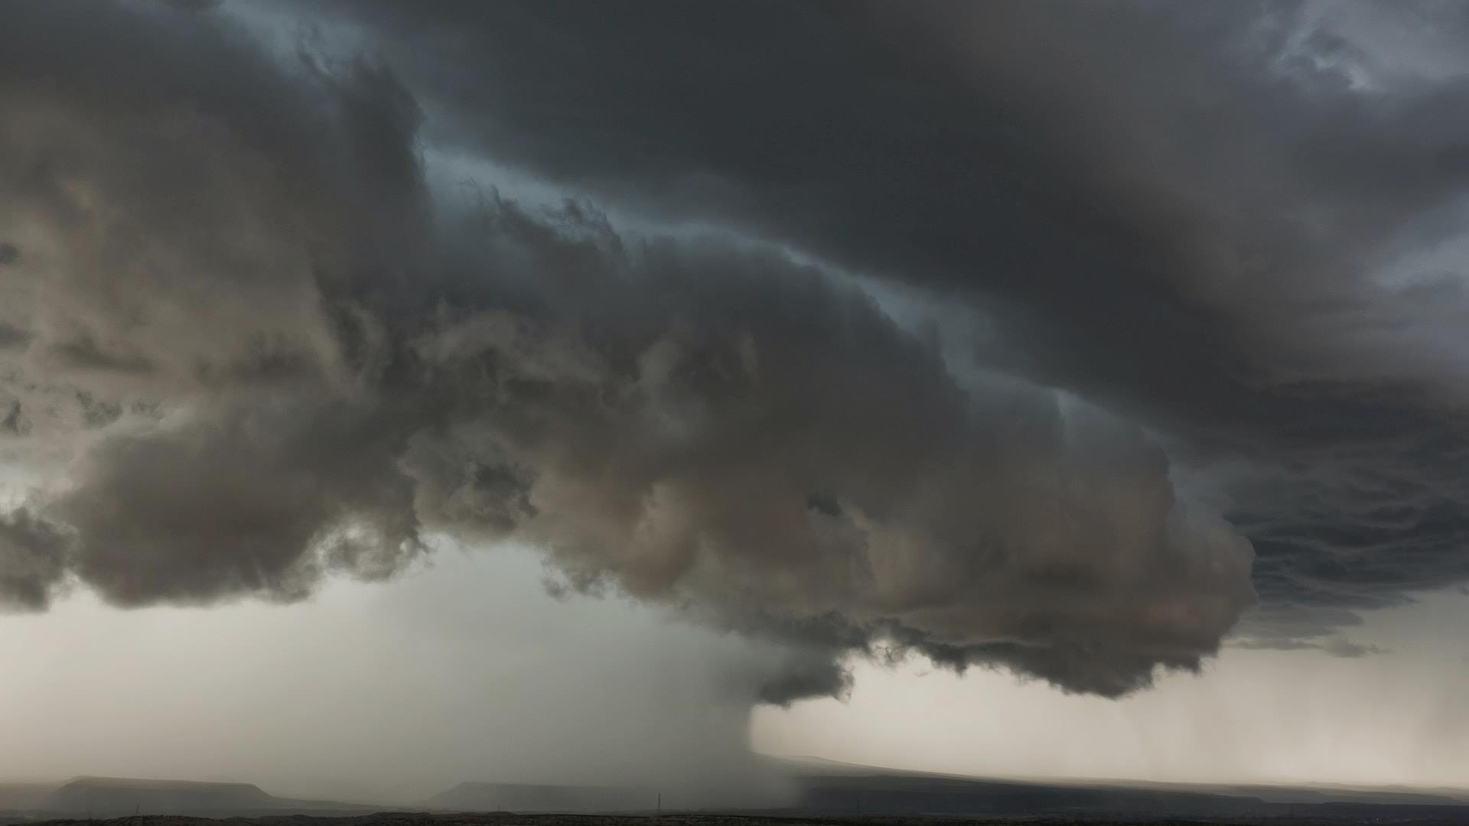
WELCOME TO THE PAWS PROJECT

Slide 2
INTRODUCTION
This project is about the front end development of a website used by dog owners for finding suitable dogs for breeding purposes.
To meet other dogs which are suitable and close by.

Slide 3
TOOLS USED
HTML
CSS
Bootstrap

Slide 4
DESIGN PROCESS
The initial structure of the website was built using HTML.
The styling and appearance of the website was designed using CSS and Bootstrap.

Slide 5
CONCEPTS USED
The Bootstrap Navigation Bar
Bootstrap Grid Layout System
Bootstrap Containers
Bootstrap Carousel
Bootstrap Cards
The CSS Z-Index and Stacking Order
Media Query Breakpoints
Refactoring the website

Slide 6

THANK YOU

